Slide 1

What Has GOD Given Me?
Part 3
“Come and hear, all you who fear God, And I will declare what He has done for my soul” (Ps. 66:16).

Slide 2
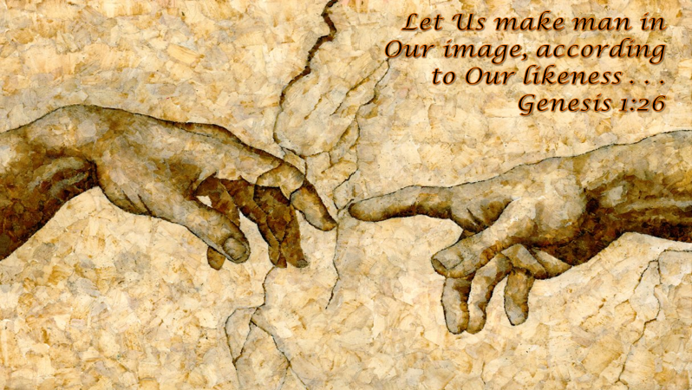
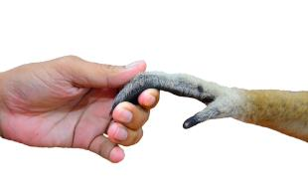
What Has God Given Me?
(1) God has given me HIS IMAGE Gen. 1:26
Not a glorified animal!
James 3:9, “With it we bless our God and Father, and with it we curse men, who have been made in the similitude of God.”

Slide 3
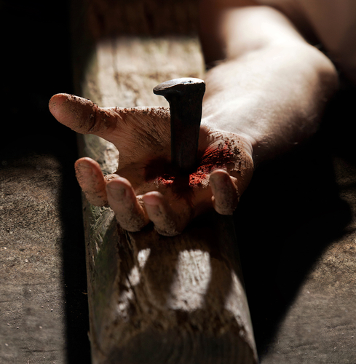
What Has God Given Me?
(2) God has given me HIS SON Jn. 3:16
Galatians 2:20, “I have been crucified with Christ; it is no longer I who live, but Christ lives in me; and the life which I now live in the flesh I live by faith in the Son of God, who loved me and gave Himself for me.”

Slide 4

What Has God Given Me?
(3) God has given me HIS MIND (1 Cor. 2:9-16)
1 Cor. 2:12, “Now we have received, not the spirit of the world, but the Spirit who is from God, that we might know the things that have been freely given to us by God.”

Slide 5
GOD
What Has God Given Me?
(4)
has given me
HIS PROMISES

Slide 7
“by which have been given to us exceedingly great and precious promises, that through these you may be partakers of the divine nature, having escaped the corruption that is in the world through lust.”
2 Peter 1:4

Slide 8
Seven Promises OF GOD
What Has God Promised Me?

Slide 9
All things that pertain to life and godliness (2 Pet. 1:3)
Pardon (1 Pet. 3:21; Col. 2:12, 13)
Strength and comfort in times of need (1 Pet. 5:7; 1 Cor. 10:13)

Slide 10
A crown of life with inheritance
JAMES 1:12
Blessed is the man who endures temptation; for when he has been approved, he will receive the crown of life which the Lord has promised to those who love Him.
JAMES 2:5
Listen, my beloved brethren: Has God not chosen the poor of this world to be rich in faith and heirs of the kingdom which He promised to those who love Him?
Who Loves Him?

Slide 11
Who Loves Him?
"He who has My commandments and keeps them, it is he who loves Me. And he who loves Me will be loved by My Father, and I will love him and manifest Myself to him."
John 14:21

Slide 12
Judgment Day (2 Pet. 3:9, 10)
A new heaven/earth (2 Pet. 3:11-13)
A resurrection/eternal life (1 Jn. 2:25)

Slide 13
What Has GOD Given Me?
GOD has given me
HIS HOME
John 14:1-3

Slide 14
“…Come, I will show you the bride, the Lamb’s wife. And he carried me away in the Spirit to a great and high mountain, and showed me the great city, the holy Jerusalem, descending out of heaven from God, having the glory of God.”
REVELATION 21:9-11

Slide 15
2 Corinthians 5:1
“For we know that if our earthly house, this tent, is destroyed, we have a building from God, a house not made with hands, eternal in the heavens.”

